Slide 1
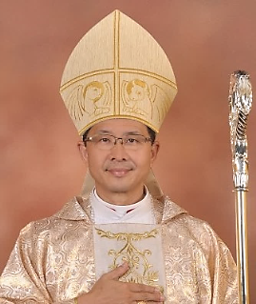
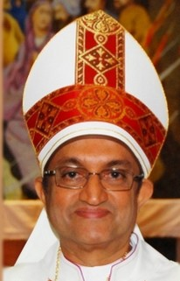
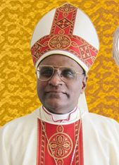
The Catholic Bishops of Peninsular Malaysia
In collaboration with the
Australian Catholic University (ACU)
GRADUATE CERTIFICATE IN LEADERSHIP AND CATHOLIC CULTURE
A 2-year virtual Executive level program aimed to equip Priests, Religious, Board Members, Managers, Senior decision makers and aspiring leaders of Catholic Diocesan Commissions, Associations, Schools and Organisations on effective leadership in leading the Catholic mission and corporate governance for sustainable and dynamic growth in the midst of global challenges.
Endorsement by the Catholic Bishops of Peninsula Malaysia
“We need leaders to be strong in faith, relevant in business and corporate life, connected in the spirit and in church, empowered to stand with courage and boldness to act by conviction at such times of change as this. This program is foundational to build such leaders amongst us” Most Rev Archbishop Julian Leow, DD |  | “Everything rises and falls with leadership – be it in the corporate world or in the church. This program will equip our leaders to rise above their set limitations to break barriers about faith and work, so that the new leader will be one with a renewed mind: fully embracing the dynamics of marketplace, leadership, ethics and justice for individuals and society” Rt Rev Bishop Sebastian Francis, DD |  | “The concept of servant leadership will be enhanced through this program which I believe is the essence of effective leadership. We need a program that builds our leaders to be open to change, be led by the Spirit and by the wisdom of the Word to serve, to govern and lead the Mission” Rt Rev Bishop Bernard Paul, DD
Course Module: Catholic Ethos and the Care of the Person Ethics in a Faith-based Context Catholic Social Thought in Practice Leading the Mission in Catholic Organisations (Note : This Graduate Certificate allows students to further their education with ACU towards higher qualifications (Masters…etc) | Duration: 2-year program consisting of 4 semesters. Each semester involves 3-months’ self-study of course material provided by the ACU, followed by 2 weekends of virtual classes with Lecturers from ACU. 2 written assignments after each contact period . Participants must complete all 4 semesters. | Requirements: Basic requirement: Degree or equivalent working experience Possess leadership qualities. Able to be groomed to bring growth and benefit back to the organization. Approval of the Bishop of your respective Diocese Cost: Total course fee: AUD1450 per participant per semester (this is a discounted rate)
Registration Deadline for June 2020 enrolment : Jan 15th 2021
The tentative contact dates are as follows : (S=Semester) S1 2021 Feb 20-21, 27-28 S2 2021 August S3 2022 February S4 2022 August | For more information, please contact any of the following : Penang Diocese: Andre Ong (012)493-7710 andrepong1@gmail.com KL Archdiocese : Patricia Pereira (016)636-8983 patriciapereira@archkl.org Malacca Johor : Deacon Anthony Chua (012)628-8779 ygchua@yahoo.com General : Andy Choong (012)228 2288 andy.g.choong@gmail.com Those from other diocese can also contact any of the above for further information. | And check out ACU’s website on the course content : https://www.acu.edu.au/about-acu/executive-education/our-courses/executive-postgraduate/graduate-certificate-in-leadership-and-catholic-culture Youtube link : https://www.youtube.com/watch?v=Rgr4c4wyr0I or search youtube for “ACU Theology & Philosophy – Leadership Matters”
You can read more about the first graduating class on the Sept 8th, 2019 issue of The Herald Catholic Weekly

